Slide 1
EVS Lecture 1.5 Topic covered: Ecosystem functioning, cycling of nutrients

Slide 2
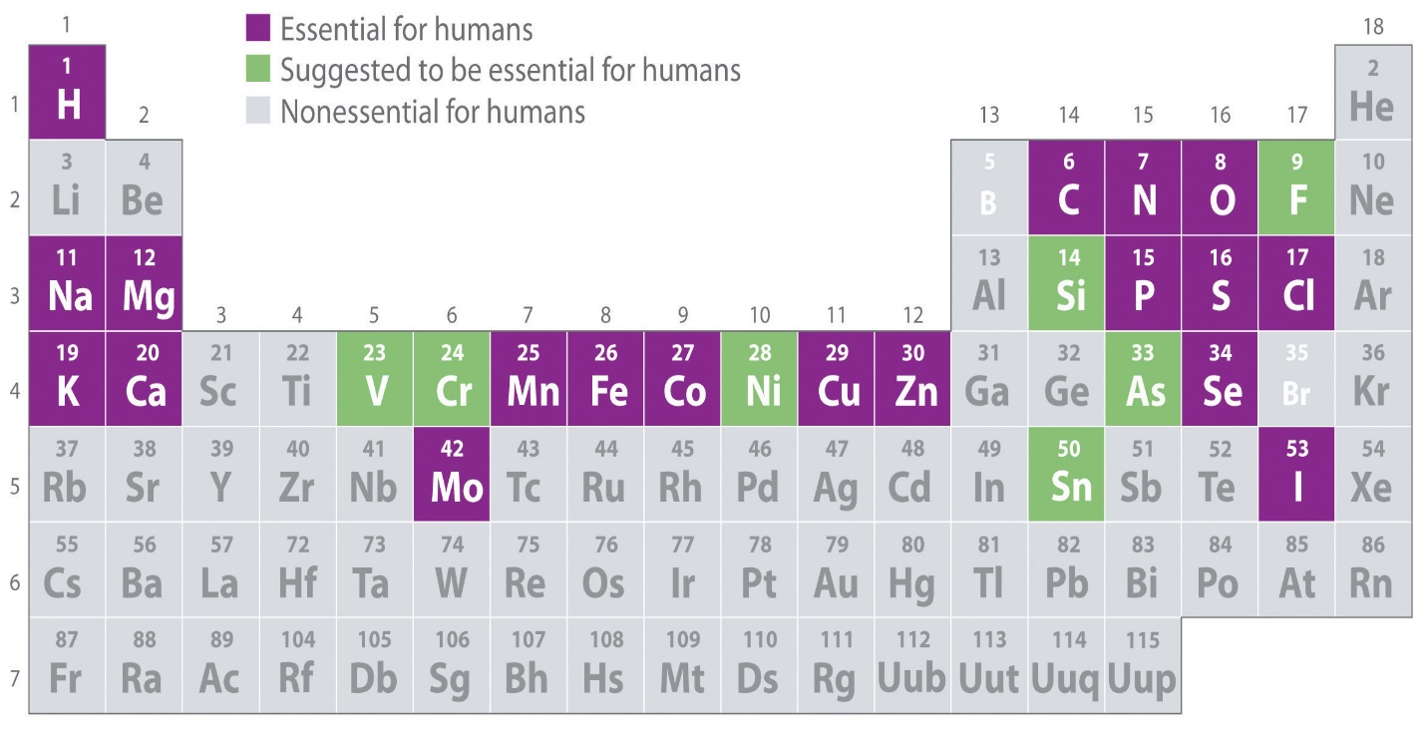
Nutrients…what are they?
The basic chemical building blocks of all life
Recycled in a living system.
Key nutrients - 95% of all living matter.
https://saylordotorg.github.io/text_general-chemistry-principles-patterns-and-applications-v1.0/s05-08-essential-elements-for-life.html

Slide 3
Residence Time
Length of time taken for a nutrient to be completely decomposed or recycled in ecosystem
Nutrient Use Efficiency (NUE) : Yield per unit input
Selective advantages in low nutrient conditions
NUE = A / L
A – the nutrient productivity (dry matter production per unit nutrient in the plant)
L – nutrient requirements per unit of plant biomass
Notes:
Turnover times are much shorter in tropical forests than in boreal forest
• Nutrients are recycled much more quickly in these ecosystems

Slide 4
Nutrient Pools and Nutrient Flux
Nutrient pool (reservoir)– a specific component or compartment where a nutrient resides
Can be a single organism, a population, a community, a trophic level, and an abiotic feature (e.g., lake, soil, atmosphere, etc.)
Nutrient flux – the rate of exchange (e.g., unit of material per unit time) of nutrients between pools
Notes:
For example, in the previous examples, the boxes represent different pools, while the arrows represent fluxes

Slide 5
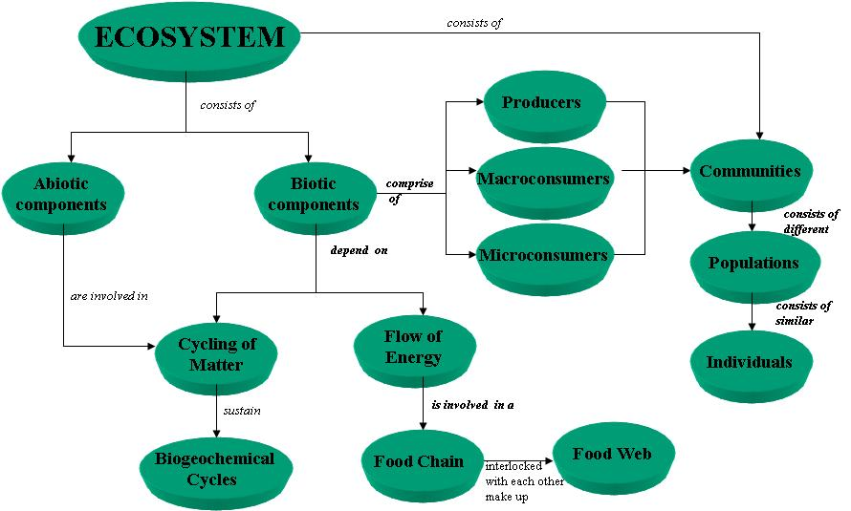
https://in.pinterest.com/pin/443815738255175532/

Slide 6
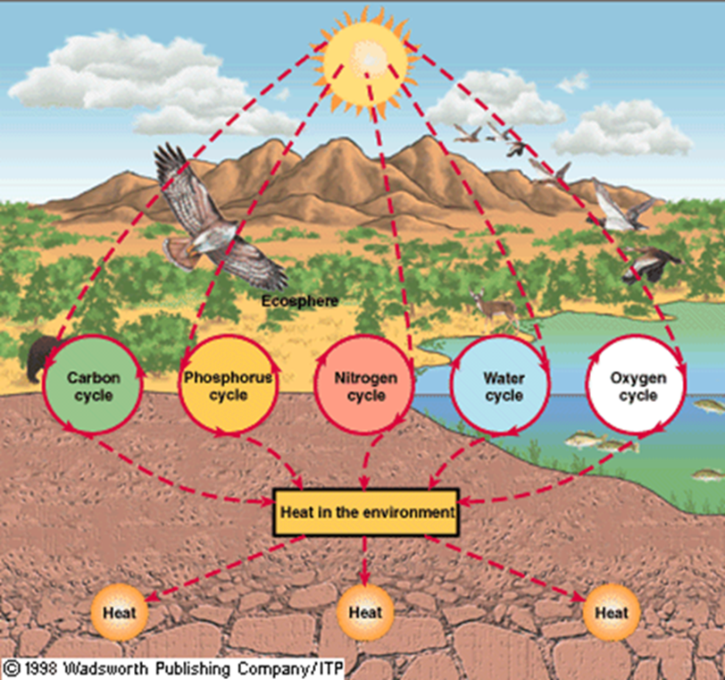
Cycling of nutrients
It is a process by which nutrients pass among different components of a cell, community, or ecosystem and can be cycled and reutilized by some of these components. These are known as Biogeochemical cycles
https://www.sciencedirect.com/topics/earth-and-planetary-sciences/nutrient-cycling

Slide 7
Biogeochemical Cycling
Vladimir Vernadsky 1934- coined this term
The cycling of nutrients through ecosystems via food chains and food webs, including the exchange of nutrients between living (the biosphere ) and the non-living (hydrosphere, atmosphere and geosphere (e.g., soils and sediments) parts of ecosystem.
Reservoir
Major categories
Sedimentary phase: Elements move from land to water to sediment. Main reservoirs are the soil and sedimentary rocks
Atmospheric phase: Elements move through the atmosphere. Main reservoirs are the atmosphere and the ocean.
Features
Biological & Chemical processes
Nutrient transformation by Oxidation, Reduction reactions
Linked
Metabolism related transformations
Global impact
https://www.jstor.org/stable/1468561?seq=1
Notes:
This is what we are going to explore more closely in this lecture

Slide 8
Factors effecting Nutrient cycling &/or availability
Transformation / cycling – oxidation or reduction reactions
Metabolism related
Mineralization
Rates of decomposition
Presence of nitrogen fixers
Microbial activity
Fire
Precipitation patterns
Soil drainage
Soil temperature, moisture
https://ecampusontario.pressbooks.pub/environmentalscience/chapter/chapter-5-flows-and-cycles-of-nutrients/

Slide 9
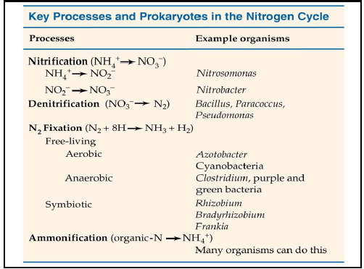
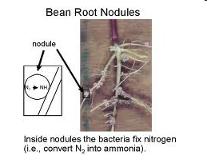
Nitrogen cycle
Key steps
Nitrogen fixation
Nitrification
Denitrification
Mineralization
https://www.researchgate.net/post/Nitrogen_cycle_in_aerobic_and_anaerobic_composting

Slide 10
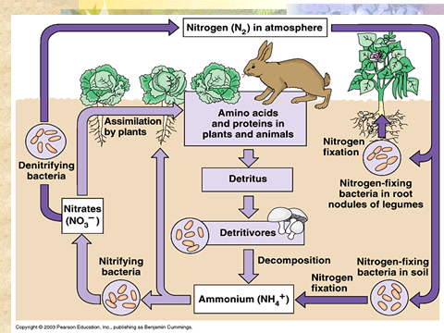
Nitrogen Fixation: Biological or chemical process where gaseous nitrogen is converted into solid forms of nitrogen.
Nitrification: The biochemical oxidation of ammonium to nitrite and nitrite to nitrate.
Denitrification: Reduction of nitrate (NO₃-) to nitrogen gas or to organic nitrogen compounds.
Mineralization/Ammonification: Organic nitrogen from decaying plant and animal residues (proteins, nucleic acids, amino sugars, urea) is converted to ammonia (NH₃) and ammonium (NH₄+)
https://temperategrasslands-badlands.weebly.com/human-impact.html

Slide 11
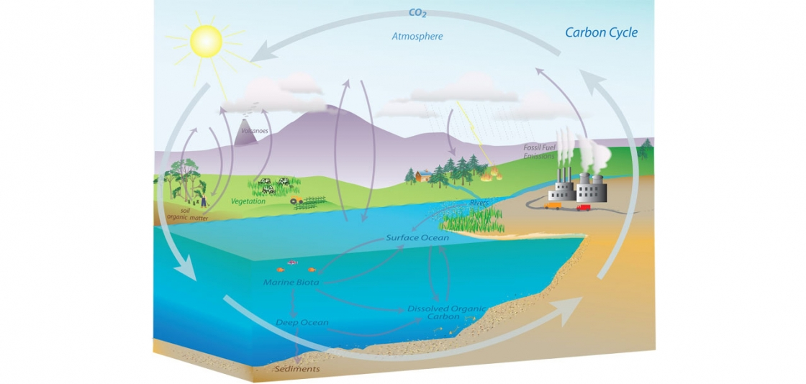
Carbon cycle
https://www.noaa.gov/education/resource-collections/climate/carbon-cycle

Slide 12
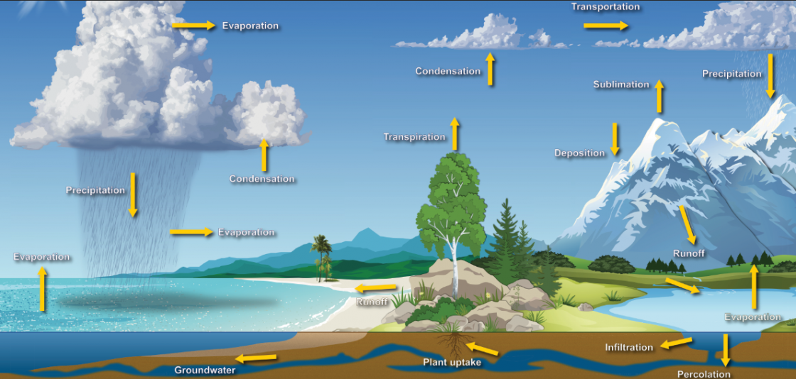
Water cycle
https://www.noaa.gov/education/resource-collections/freshwater/water-cycle

Slide 13
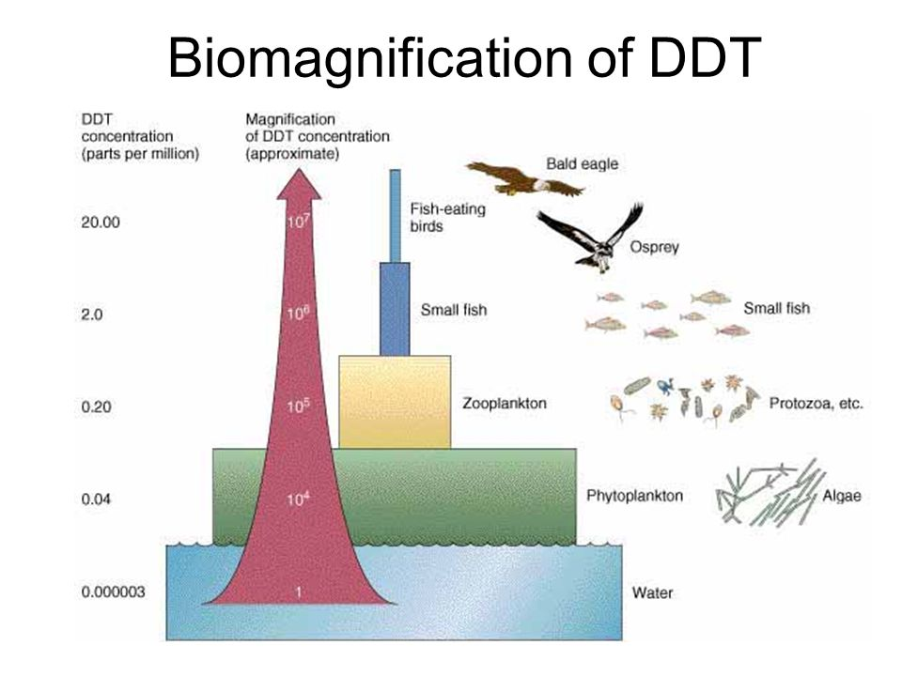
Bioaccumulation & Biomagnification
Bioaccumulation:
Increase in concentration of a pollutant from the environment to the first organism in a food chain
Biomagnification:
Increase in concentration of a pollutant from one link in a food chain to another
DDT has a half-life of 15 years
DDT has brought in the "age of resistance" - a high price to pay to have no mosquitoes.
https://slideplayer.com/slide/7788538/

Slide 14
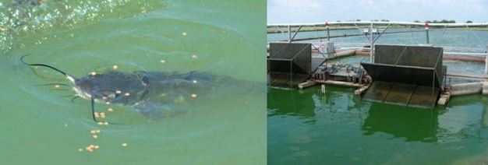
Eutrophication
Eutrophication is characterized by excessive plant and algal growth due to the increased availability of one or more limiting growth factors needed for photosynthesis (Schindler 2006), such as sunlight, carbon dioxide, and nutrient fertilizers.
It can occur naturally as lakes age and are filled in with sediments (Carpenter 1981). Recently, human activities have accelerated the extent of eutrophication through both point-source discharges and non-point loadings of limiting nutrients, such as nitrogen and phosphorus, into aquatic ecosystems
leading cause of impairment of many freshwater and coastal marine ecosystems in the world
Aquaculture ponds typically contain high concentrations of nutrients, such as nitrogen and phosphorus, due to regular feeding of the fish. Consequently, these ponds are also plagued by recurring cyanobacterial blooms and hypoxia.
© 2013 Nature Education Photos by Mark Peterman and Michael Chislock. All rights reserved. View Terms of Use
https://www.nature.com/scitable/knowledge/library/eutrophication-causes-consequences-and-controls-in-aquatic-102364466/

Slide 15
Gaia Hypothesis
James Lovelock, Lynn Margulis - 1970
Our planet functions as a single organism that maintains conditions necessary for its survival.
Single super organism- All life on earth interacts with physical factors forming a complex system.
Earth is a self-regulating system
Behaves like a human body, homeostasis
Gaia, therefore, can be viewed as a study of the physiology of the Earth, where the oceans and rivers are the Earth's blood, the atmosphere is the Earth's lungs, the land is the Earth's bones, and the living organisms are the Earth's senses.
https://courses.seas.harvard.edu/climate/eli/Courses/EPS281r/Sources/Gaia/Gaia-hypothesis-wikipedia.pdf

